Slide 1

Function Based Hand Gesture Detection Using Image
Group 12
Vairag Parikh (1153939)
Udhaya Kumar Rajendran (1134990)

Slide 2

Introduction

Slide 3

Gesture Importance

Slide 4
Role in creating Language

Slide 5
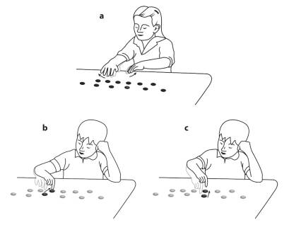
Reveals understanding not found in speech
Krauss RM, Chen Y, Chawla P. Nonverbal behavior and nonverbal communication: What do conversational hand gestures tell us? Advances in Experimental Social Psychology. 1996;28:389–450.

Slide 6
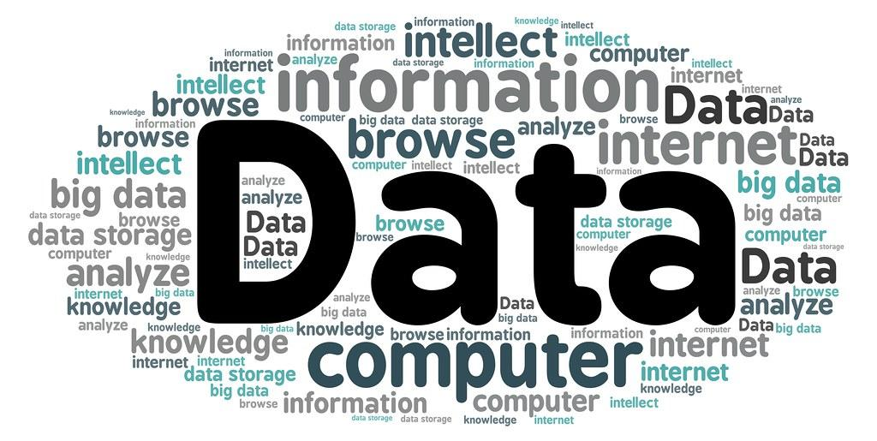
Dataset
￼

Slide 7
Kaggle Datasets
Hand Gesture Recognition - Leap Motion
American Sign Language - Ayush Thakur

Slide 8
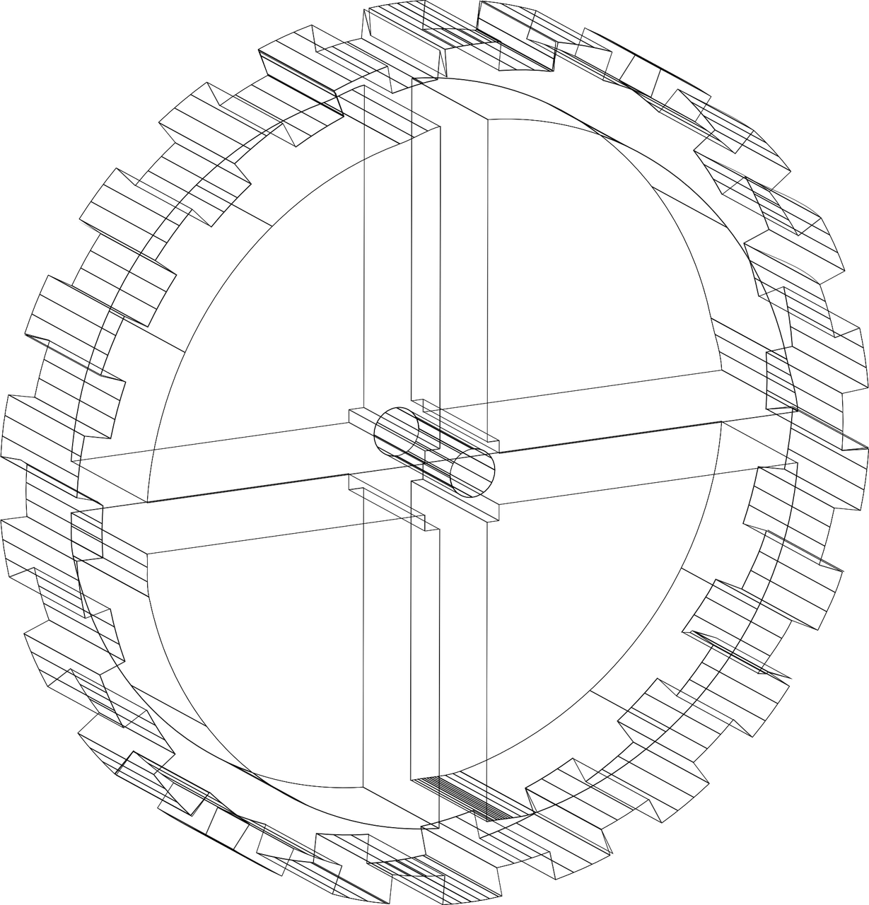
Models for Prediction

Slide 9

CNN v/s SVM
Does CNN really has a significant advantage over SVM ?

Slide 10
Considering Huge Dataset.
Model Complexity
Network Efficiency
Accuracy and Speed
Train and Test Time
Detecting Local Relationship

Slide 11
Pre-Processing

Slide 12
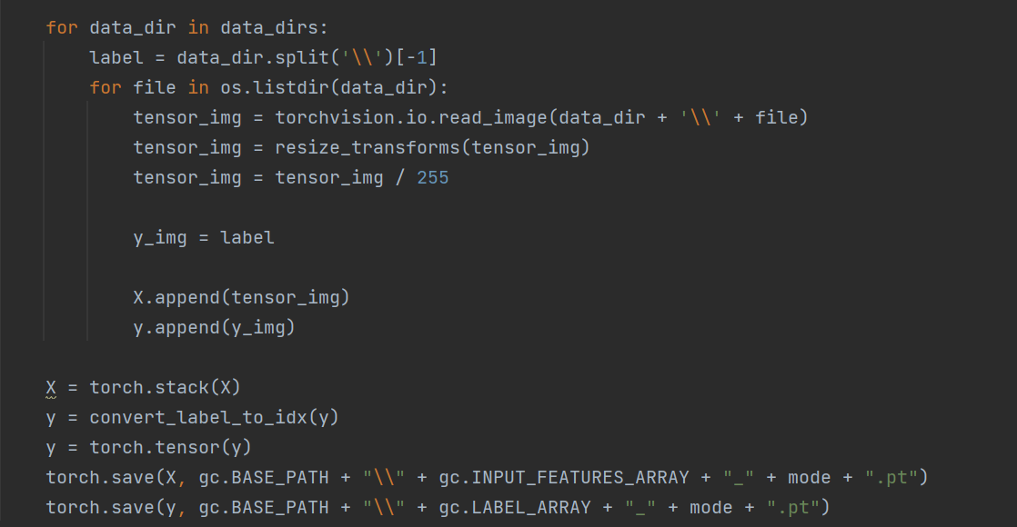
Images to Pixels

Slide 13

Why Binary Images?

Slide 14
Resizing

Slide 15
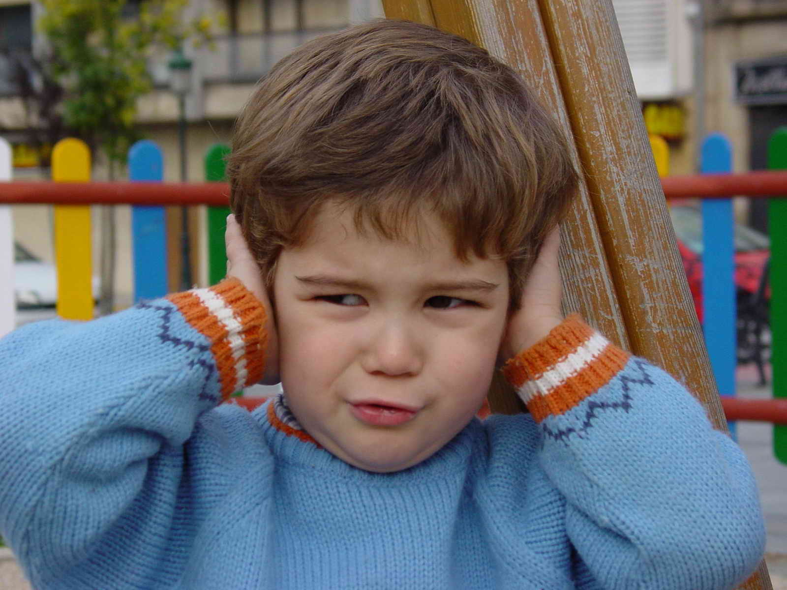
Background Noise ?

Slide 16

Brightness ?

Slide 17
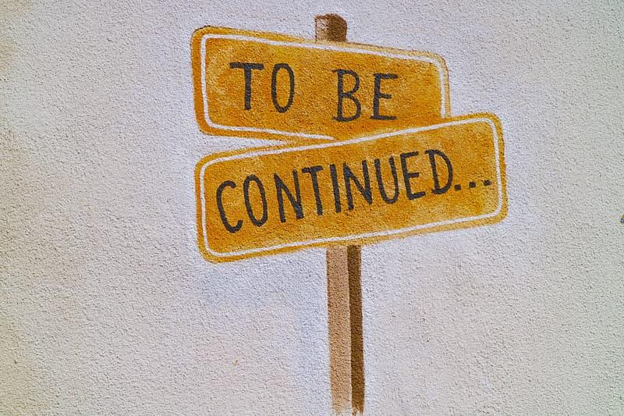
Interval

Slide 18
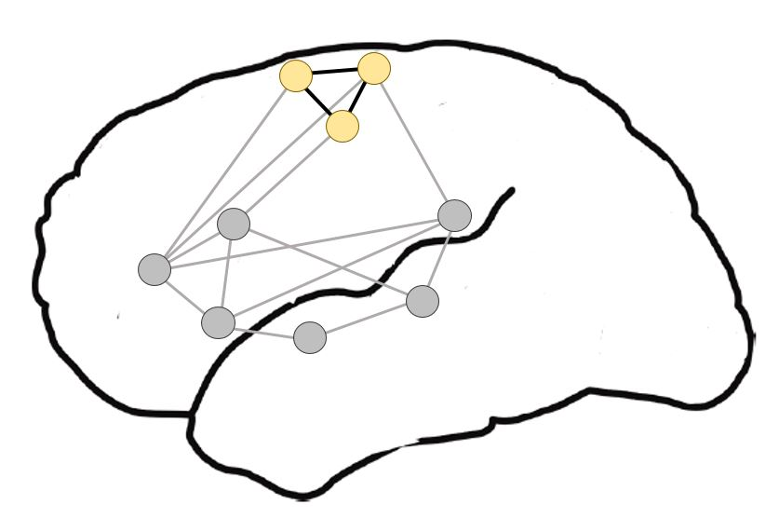
CNN

Slide 19

Defination

Slide 20

Working

Slide 21

Training Knowledge

Slide 22
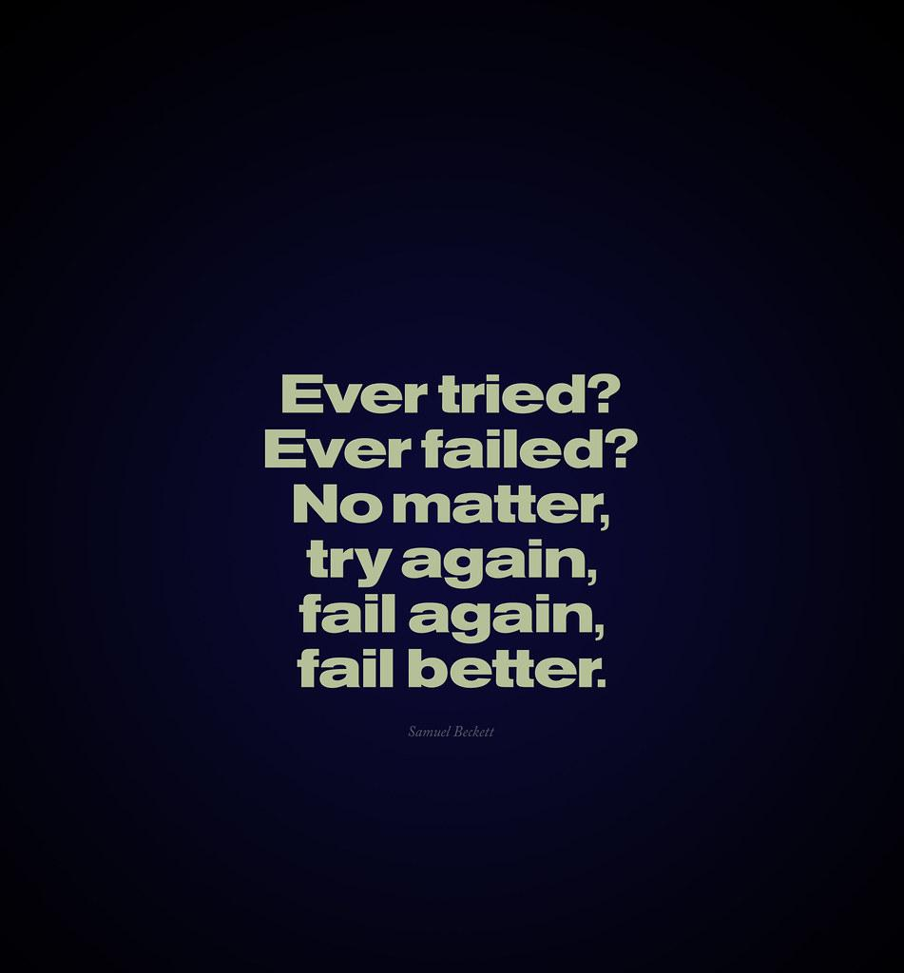
More Iteration

Slide 23
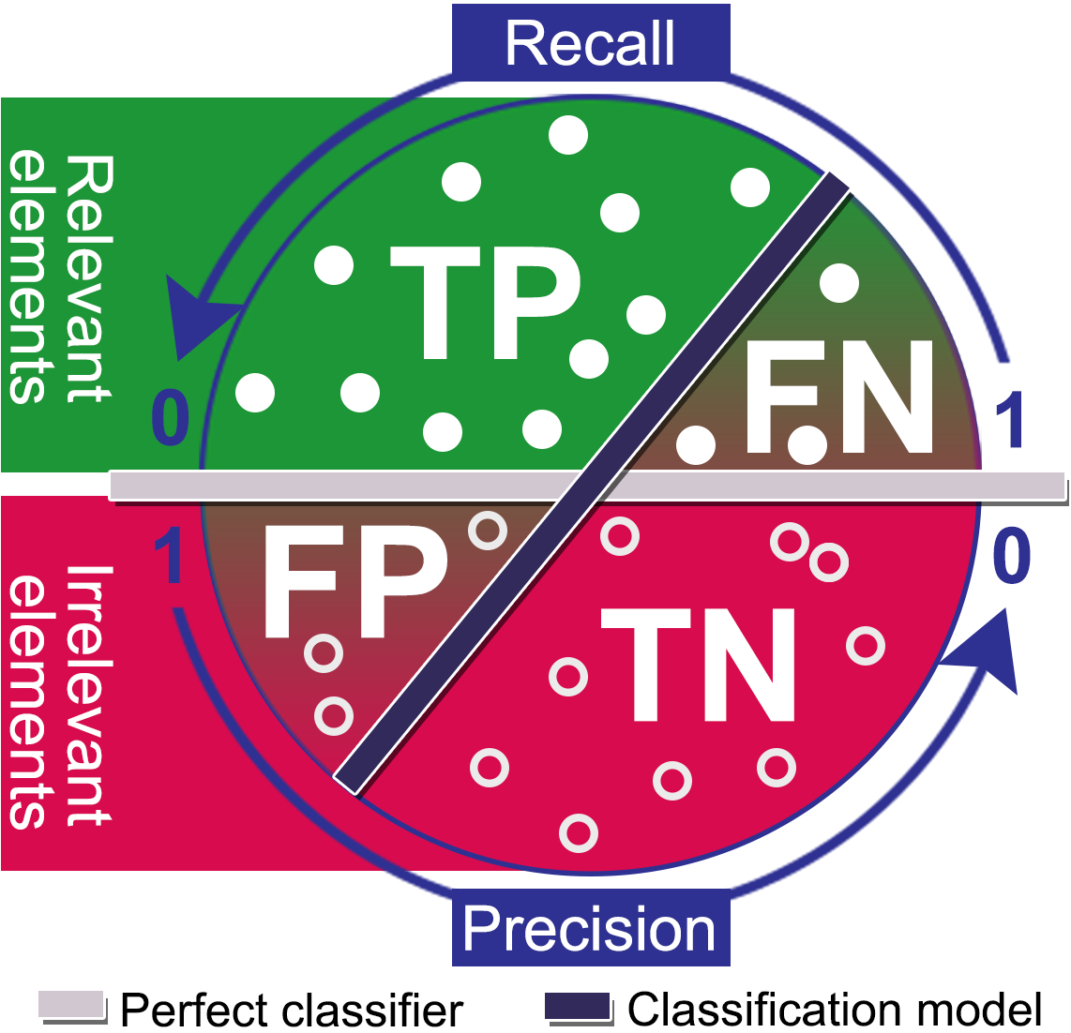
Accuracy / Precision / Recall

Slide 24
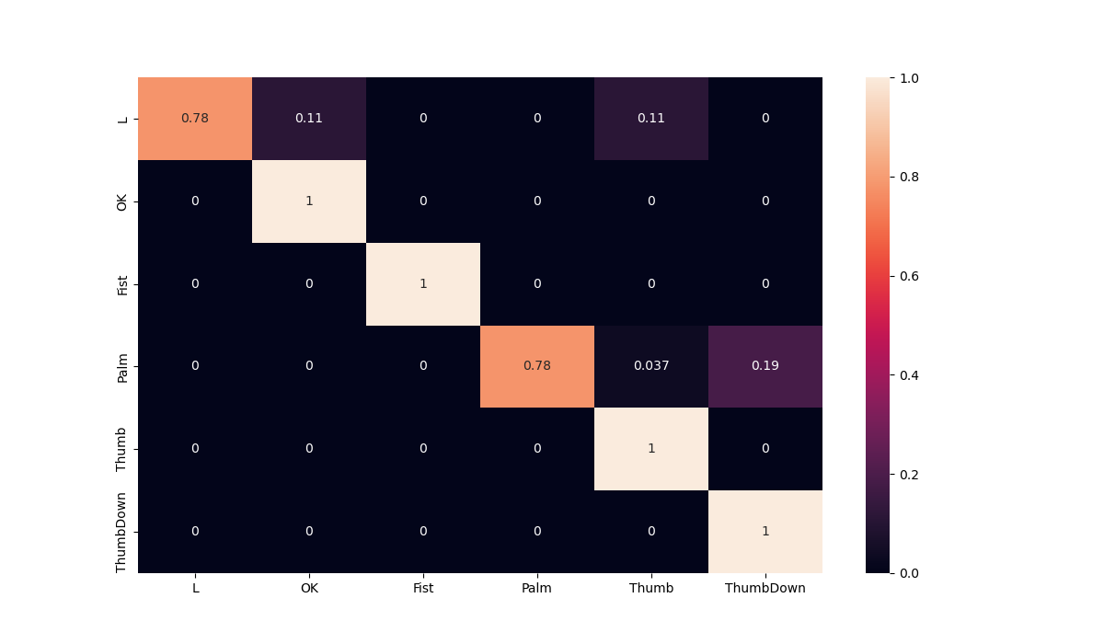
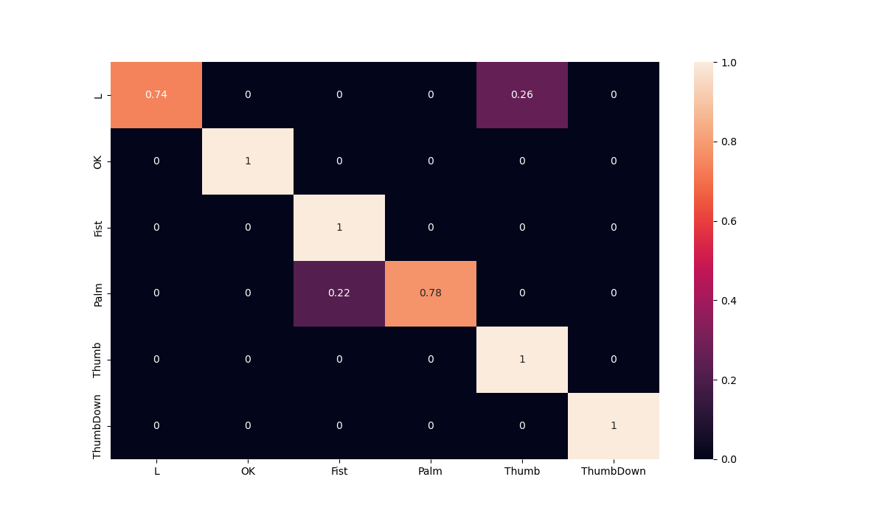
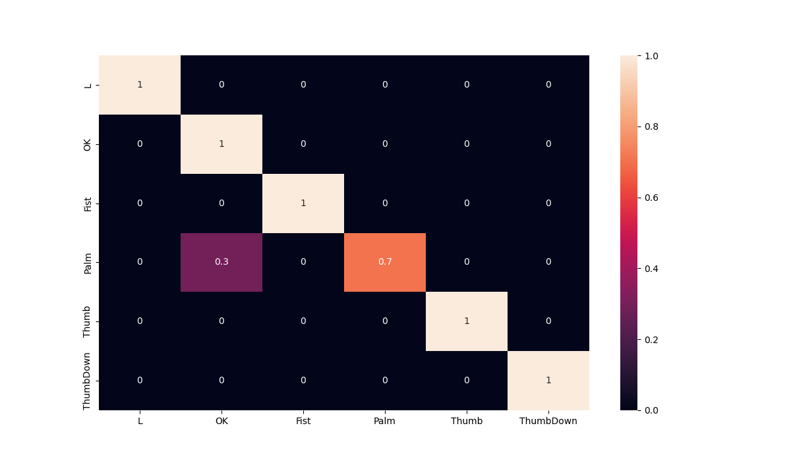
Epochs and Confusion Matrix
20 Epochs
10 Epochs
50 Epochs

Slide 25
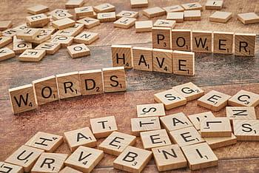
Core Implementation

Slide 26
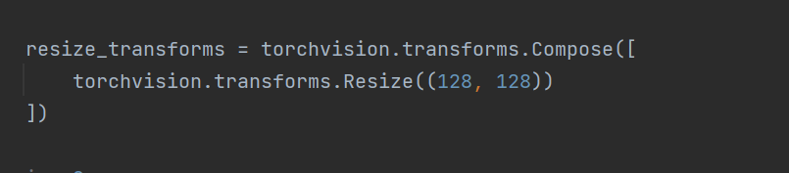
How Does it Work !! Code Snippets
Image Transformations

Slide 27
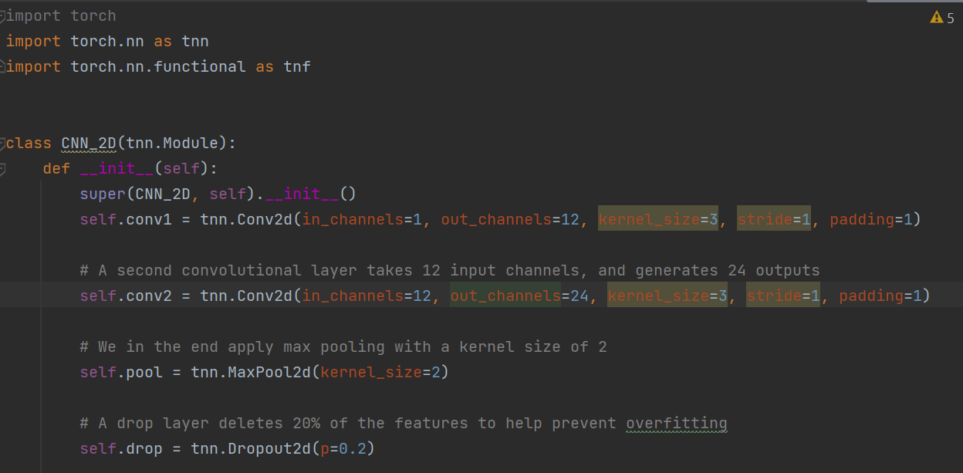
How Does it Work !! Code Snippets
CNN Model

Slide 28
How Does it Work !! Code Snippets
Parameter | Value
Input Channels | 1 (binary image)
Kernel Size | 3
Stride | 1
Padding | 1
Dropout | 0.2
Pooling | MaxPooling with Kernel size 2
Batch Size of training dataloader | 32
Learning Rate | 0.01
Number of epochs (iterations) | 3, 10, 25, 50 (different combinations)
Loss Function | Cross Entropy Loss
Optimizer | Adam

Slide 29
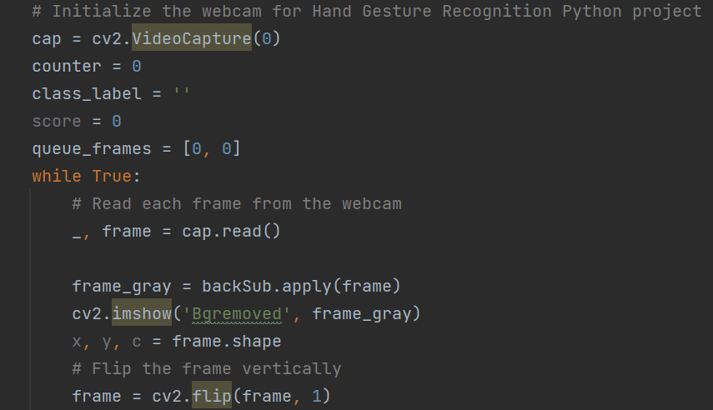
How Does it Work !! Code Snippets
Capturing Images through Webcam

Slide 30
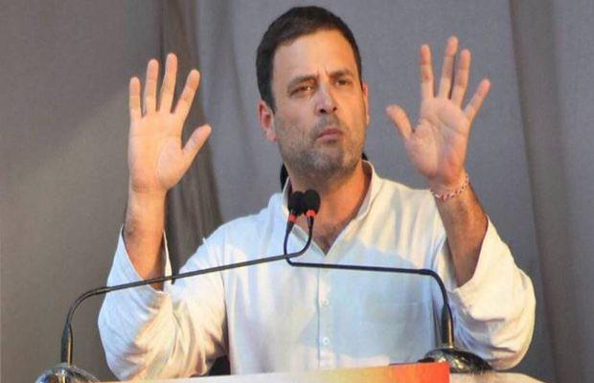
Questions :
Feel Free to ask!

Slide 31
THANK YOU

